Slide 1




Chapter 11:
FIlecoin Storage Market
Beginners Guide to Filecoin
Content created by Brown Zhang
Researcher @ KEN Labs

Slide 2
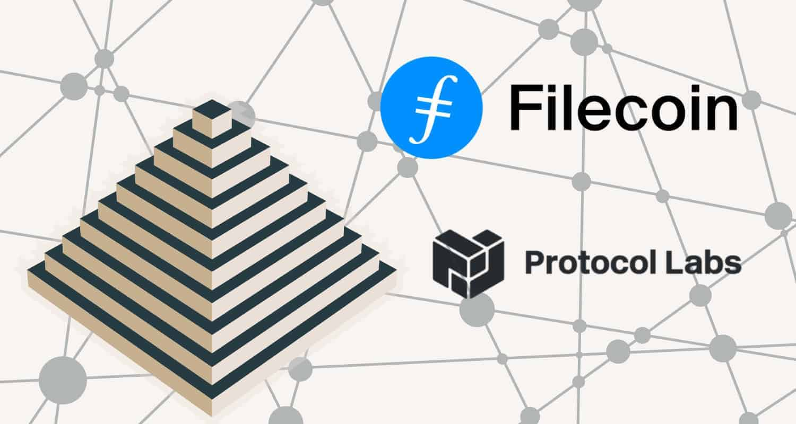
Introduction
The Filecoin network achieves economies of scale by allowing anyone to participate as a storage provider. Currently the network is made up of hundreds of storage providers spread across the globe. Content addressing and cryptographic storage proofs verify that data is being stored correctly and securely over time on miners’ hardware, which creates a robust and reliable service.

Slide 3
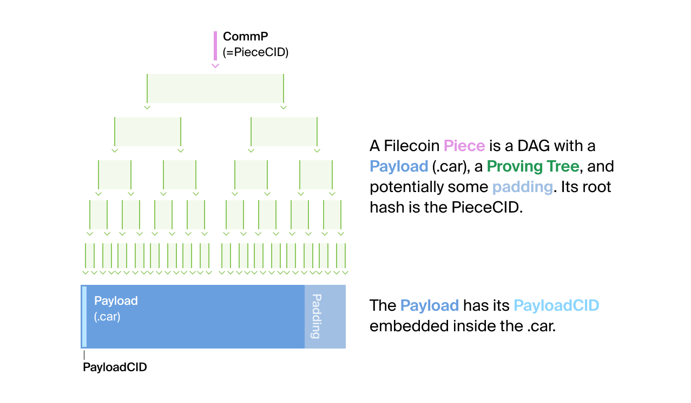
Data on Filecoin
Store file on Filecoin(Data):
Clients import file in their local Filecoin node.(produce a data CID)
Clients initiate a deal.(take a data CID as input, produce a Filecoin Piece)
The Filecoin Piece is the main unit of negotiation for data that users store on the Filecoin network.
A Filecoin Piece is a CAR file containing an IPLD DAG with its own data/payload CID and piece CID.
CAR file is a serialised representation of any IPLD DAG as the concatenation of its blocks

Slide 4
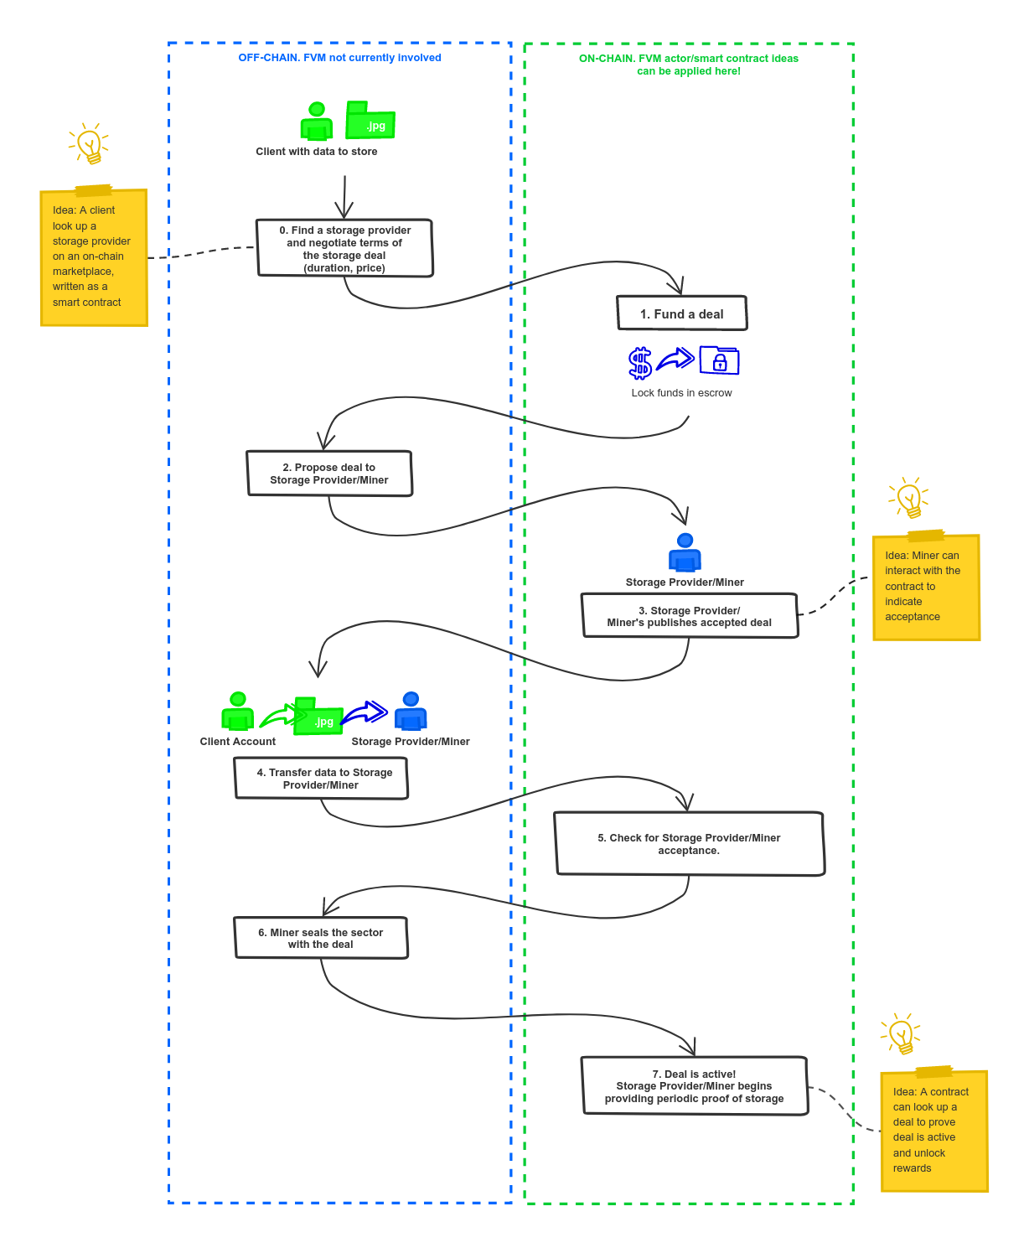
The Storage Deal Flow
Users can store data in and retrieve data from the Filecoin network via deals. Participants in the network, miners (supply-side) and clients (demand-side), interact with each other via storage deals and retrieval deals.

Slide 5
The Storage Mining subsystem
The Storage Mining subsystem ensures miners can effectively commit storage to the Filecoin network, and:
Committing new storage and registering new sectors
1
Participate in the Filecoin Storage Market by taking on client data and participating in storage deals.
Participate in Filecoin Storage Power Consensus, verifying and generating blocks to grow the Filecoin blockchain and earning block rewards and fees for doing so.
2
Continuously proving storage (see WindowPoSt)
Declaring storage faults and recovering from them (see Faults)
3

Slide 6
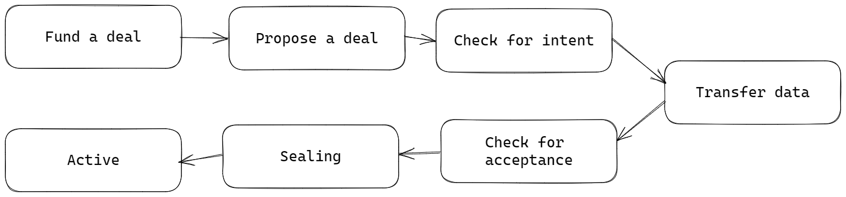
Storage miner and client considerations
From the perspective of a client who wants to store data on Filecoin, the deal passes roughly through the following stages:

Slide 7
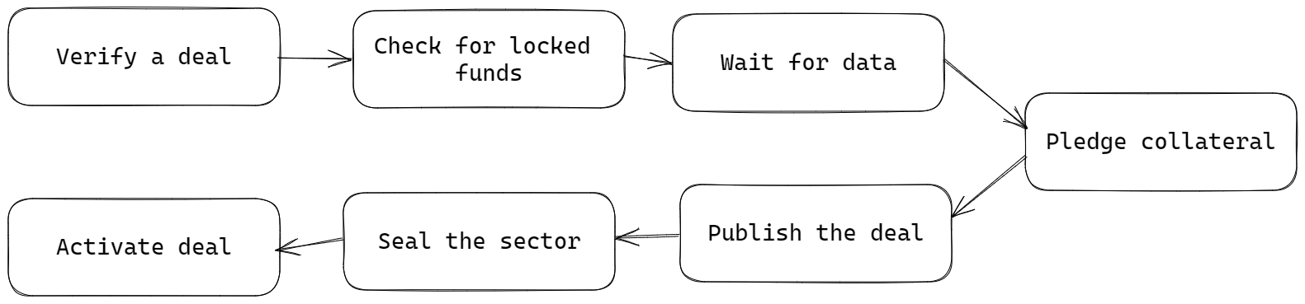
Storage miner and client considerations
From the perspective of a miner who provides a service to the client by storing their data, the deal passes roughly through the following stages:

Slide 8
Proof-of-Spacetime
Winning Proof-of-Spacetime (WinningPoSt) is the mechanism by which storage miners are rewarded for their contributions to the Filecoin network.
Proof-of-Spacetime manifests in two distinct varieties in Filecoin today:
Window Proof-of-Spacetime (WindowPoSt)
Winning Proof-of-Spacetime (WinningPoSt)

Slide 9
Winning Proof-of-Spacetime
Winning Proof-of-Spacetime (WinningPoSt) is the mechanism by which storage miners are rewarded for their contributions to the Filecoin network.
At the beginning of each epoch, a small number of storage miners are elected to each mine a new block.
Each elected miner who successfully creates a block is granted FIL (a block reward)
Storage miners who fail to do this in the necessary window will forfeit their opportunity to mine a block, but will not otherwise incur penalties for their failure to do so.

Slide 10
Window Proof-of-Spacetime
Window Proof-of-Spacetime (WindowPoSt) is the mechanism by which the commitments made by storage miners are audited by the Filecoin blockchain.
Each storage miner’s set of pledged sectors is partitioned into subsets, one subset for each window.
Within a given window (30min), each storage miner must submit a Proof-of-Spacetime for each sector in their respective subset.
The Filecoin network expects constant availability of stored data. Failing to submit WindowPoSt for a sector will result in a fault, and the storage miner supplying the sector will be slashed. This incentives storage miners for healthy behaviour.

Slide 11
Faults
Miners are penalized when a sector fails.
There are three types of sector fault fees:
Sector fault fee - This fee is paid per sector per day while the sector is in a faulty state.
Sector fault detection fee - This is a one-time fee paid in the event of a failure if the miner does not report it honestly and instead the unreported failure is caught by the blockchain.
Sector termination fee - A sector can be terminated before its expiration date through automatic faults or miner decisions.

Slide 12
Conclusion
This video post explains how Filecoin deals work from the perspective of both the storage providers (also known as miners) and the clients who want to store data on the Filecoin network.

Slide 13

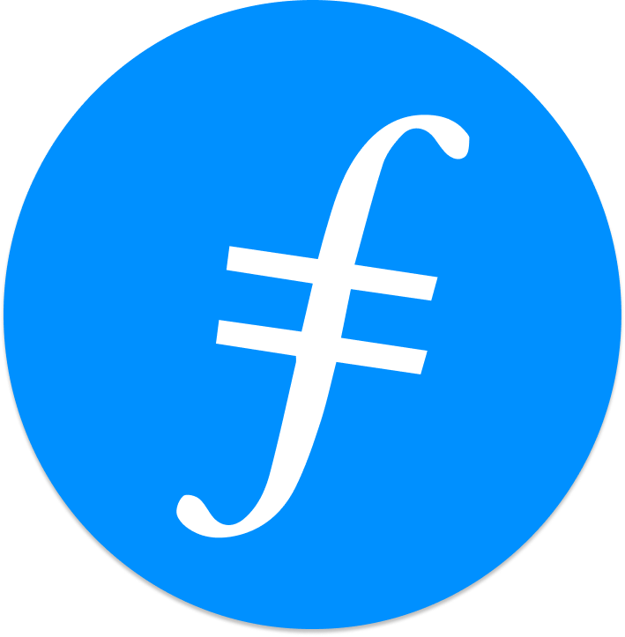
Feedback is welcomed.
https://github.com/kenlabs/Beginners-Guide-to-Filecoin

